Slide 1
Latest Acquisitions part II
21st January 2021
Peter McCann

Slide 2
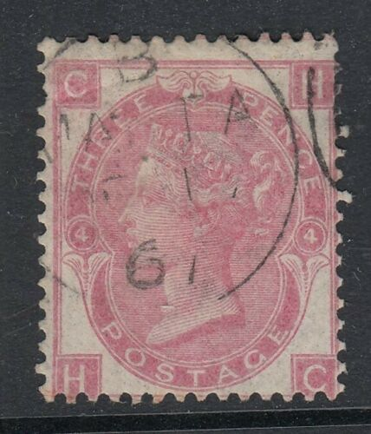
SG103 plate 4 cds
Took ages to find this
Bit grubby, poorly centred but it was cheap ($9.15) possibly because I bought it on USA eBay
Malta cds, 1867, early use

Slide 3
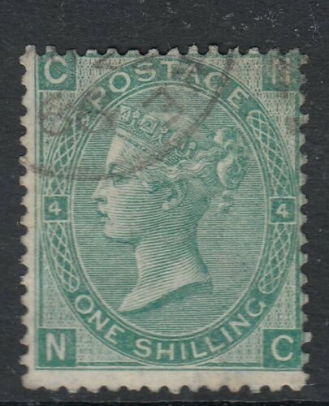
SG101 plate 4 cds
Again poorly centred and NE corner grubby
Note the 1866 date cancel
Just a few quid so I can wait for a superior copy

Slide 4
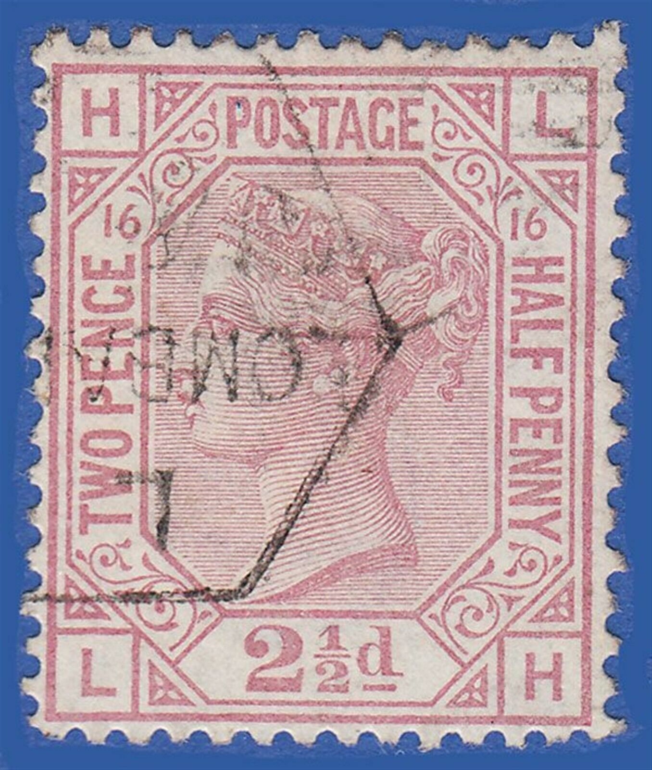
SG141 plate 16
I’ve completed this set now after 20 years
Each plate with a cds. A very common stamp but very tricky with cds
I treated myself to this this week. A lovely stamp
Lombard Street cancel

Slide 5
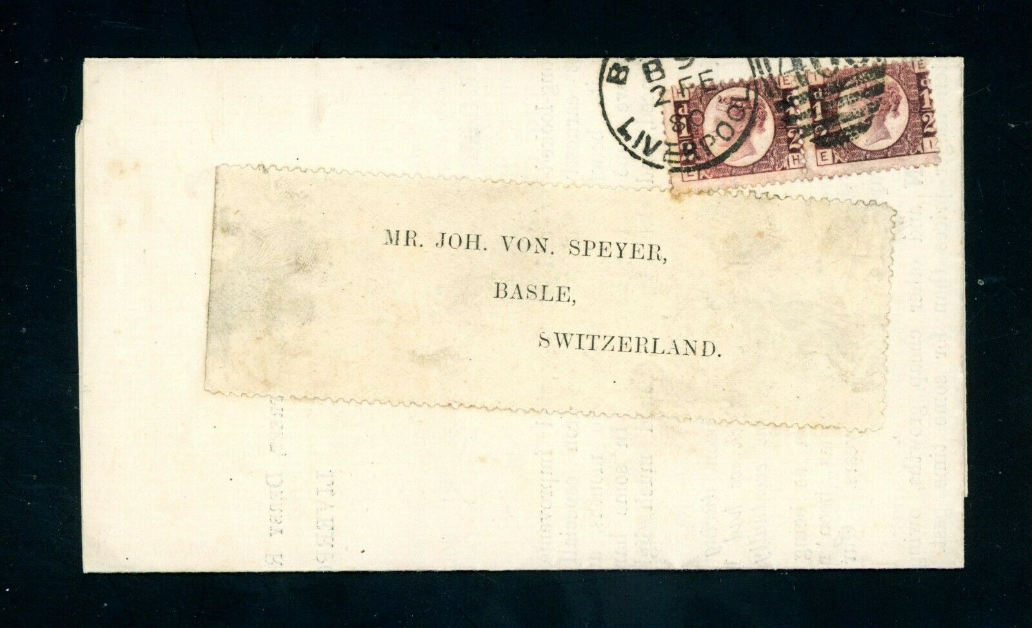
Preston industrial history
Pair of ½d bantams plate 19
Sent from Bootle 2nd February 1880 to Switzerland. Advert was enclosed (see next page)
A very good value item, £24 (the plate 19 stamp off cover is cat £55 in my 2006 SG spec vol 1)

Slide 6
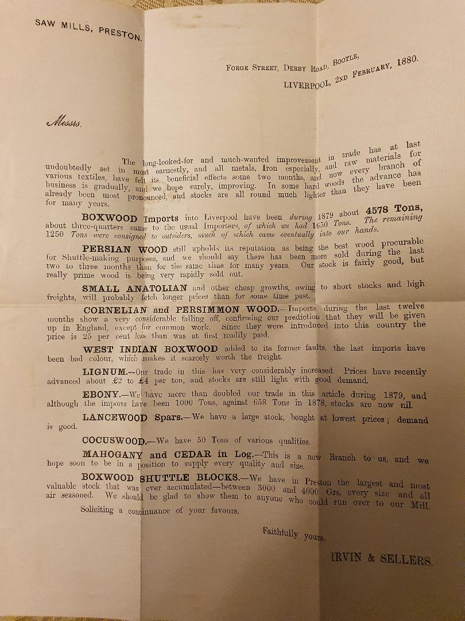
Lovely printed advert
Sent from Irvin and Sellers
Preston saw mill
Timber merchant
Made bobbins and shuttles
Peel Hall Works, Fletcher Road

Slide 7
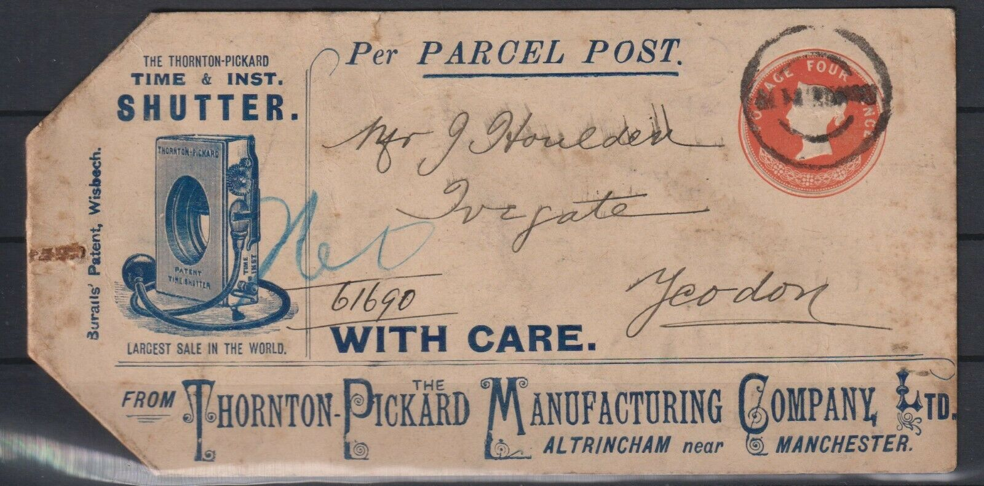
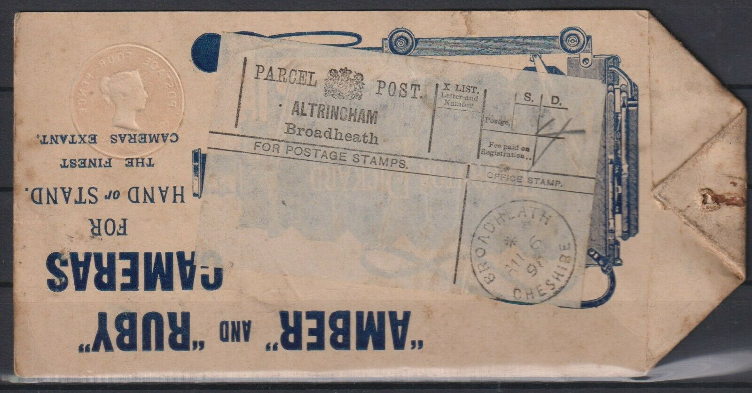
Lovely parcel label 6th August 1898 (4d rate)

Slide 8
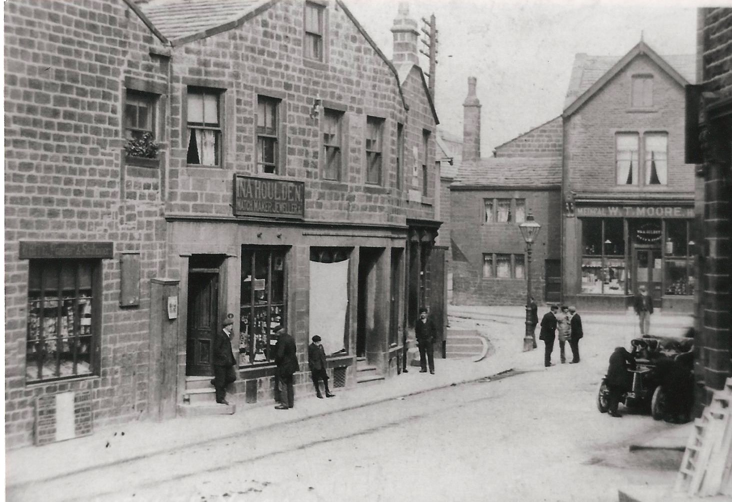
A 1908 photo (sourced from Aireborough Historical Society) showing Houlden’s jewellers shop in Ivegate, Yeadon nr Otley – the address on the label!

Slide 9
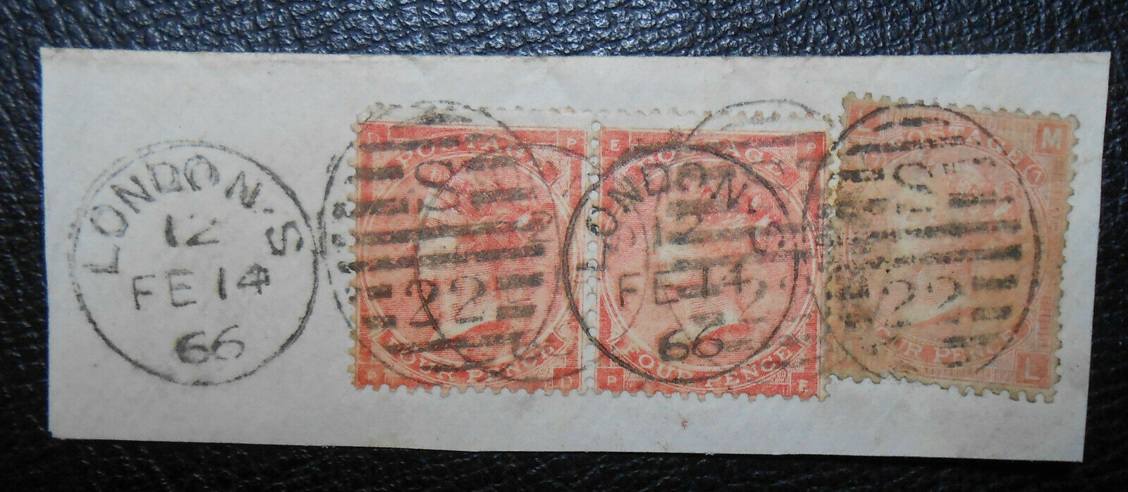
4d red (pair) plus 4d vermilion
1866. 4d small letters (plate 4) and 4d large letters (plate 7) on the same small piece. Only 1 other example is recorded. A bit messy and faded but very rare

Slide 10
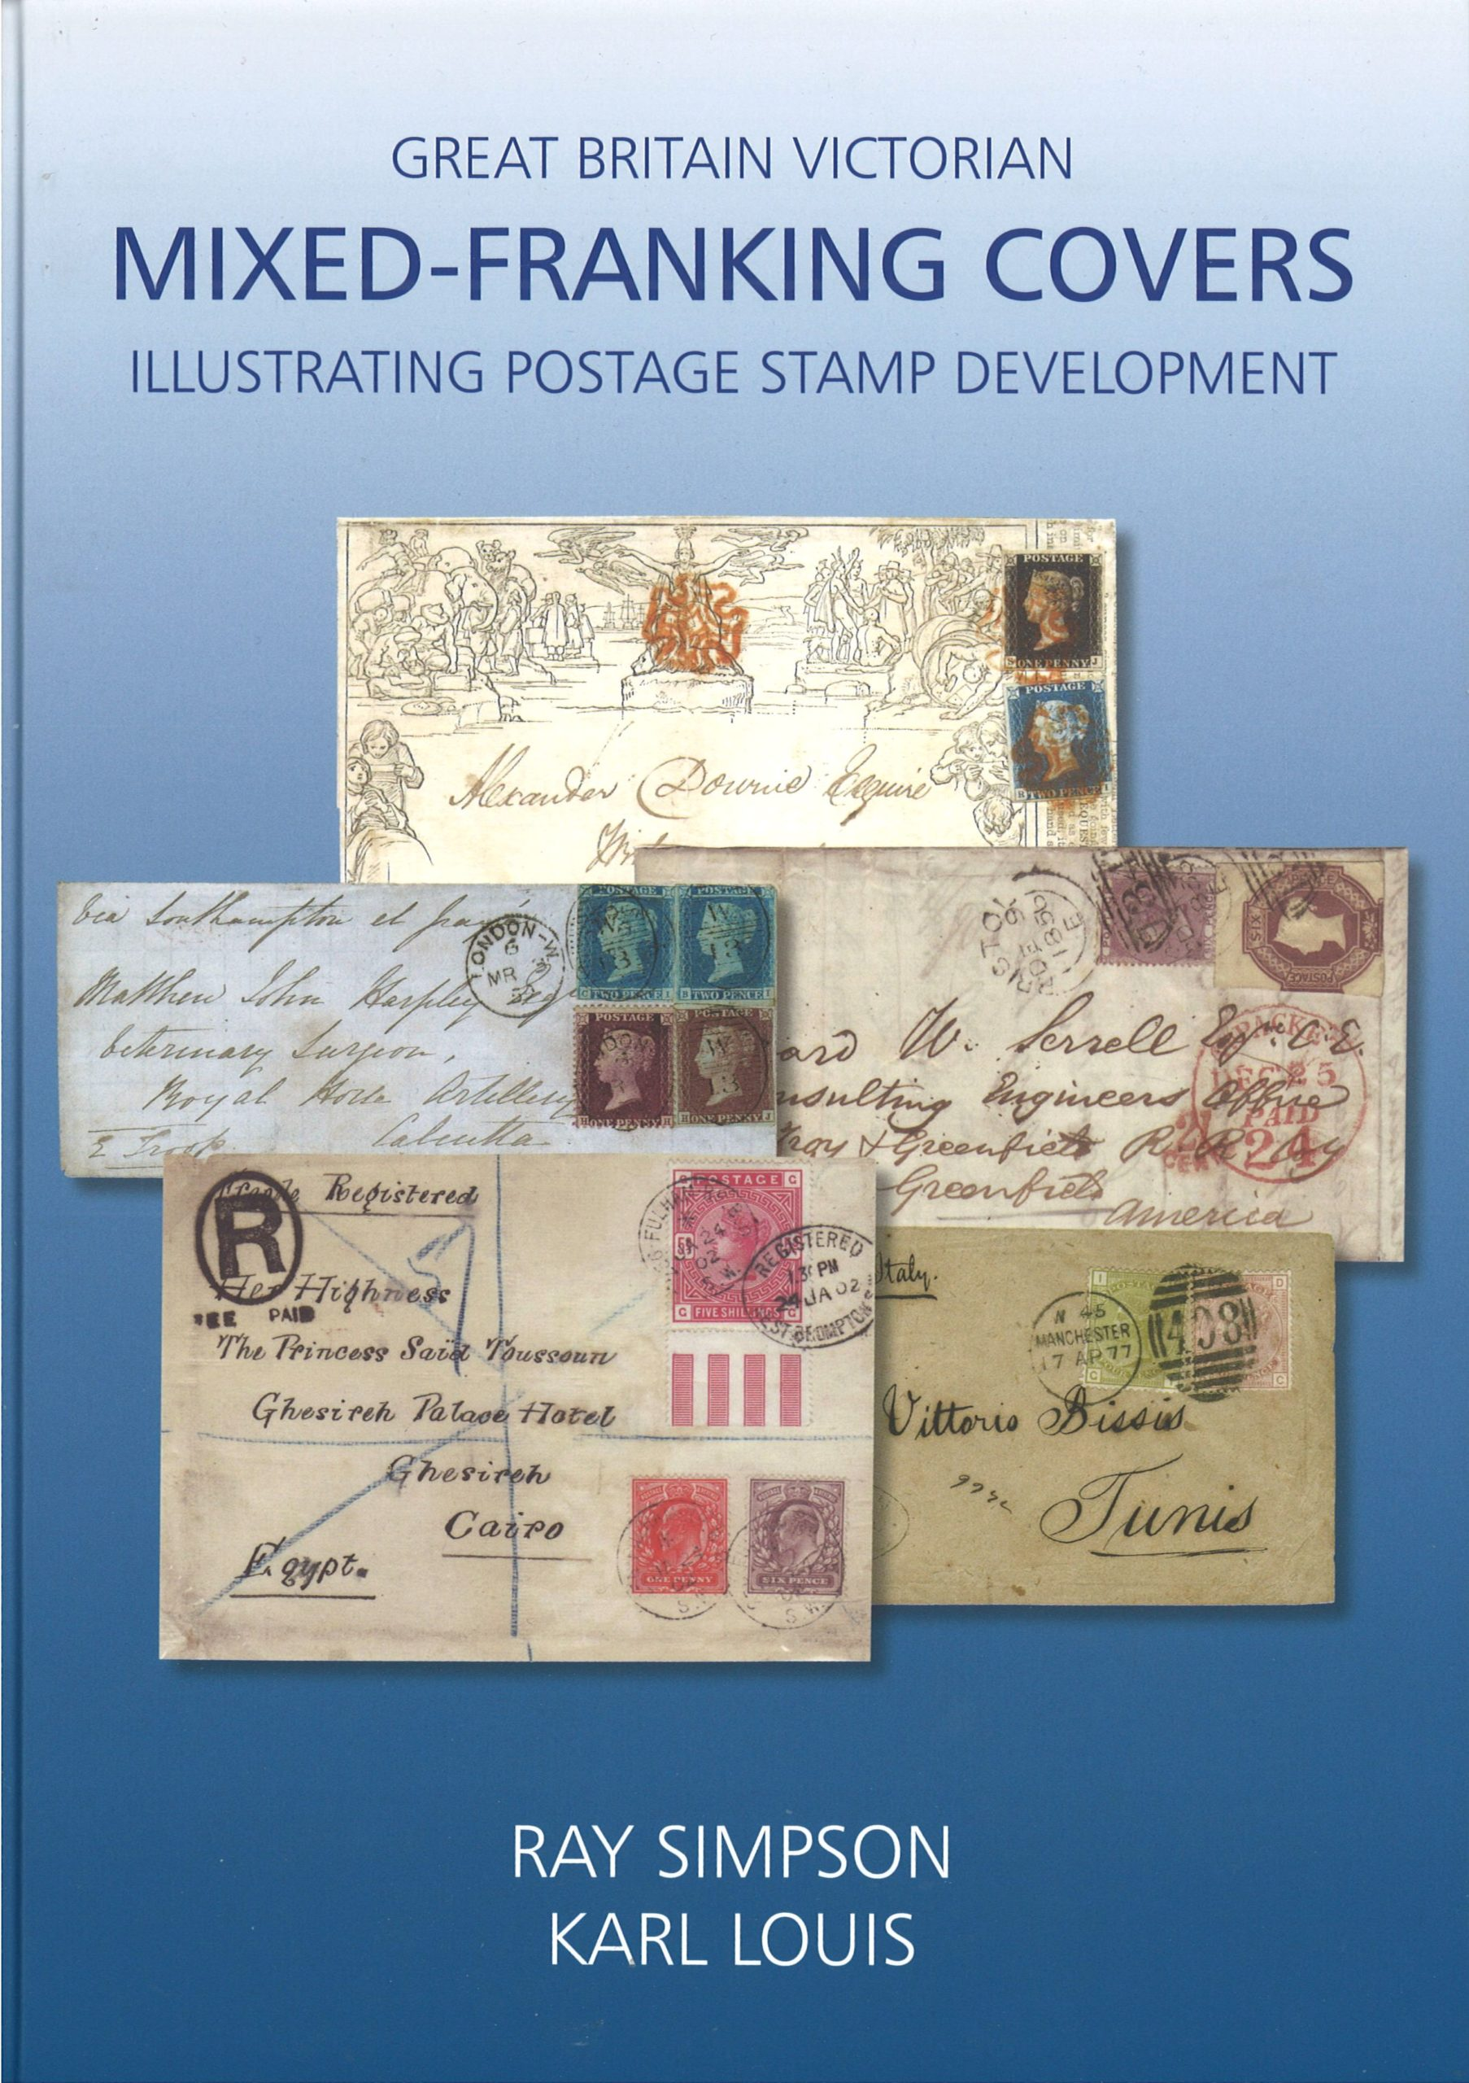
New books
Very good book looking at covers with mixed stamps that shouldn’t really be together
Knowledge is so important in philately

Slide 11
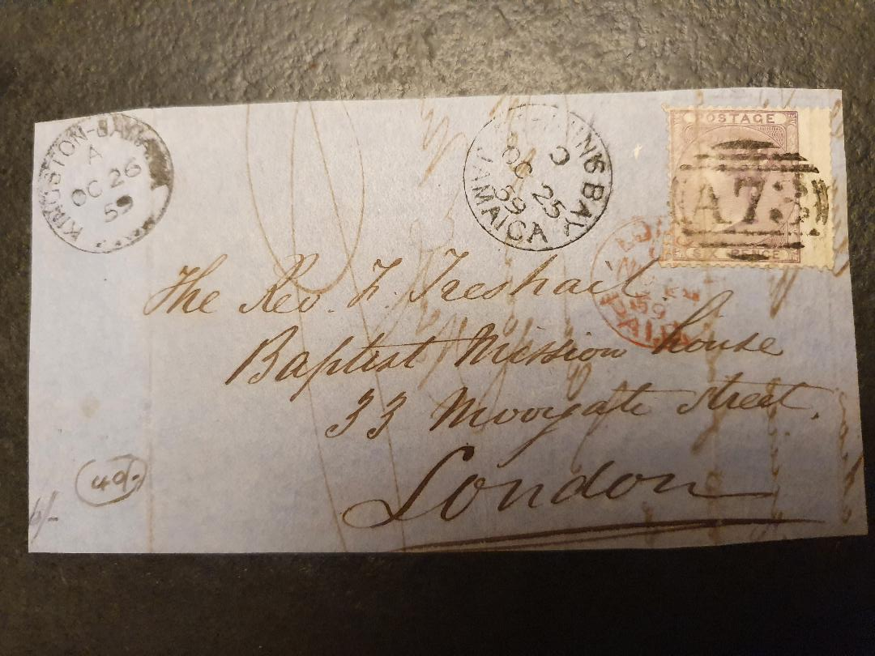
Stamps used abroad
6d lilac sent from St Ann’s Bay, Jamaica to London
Cancelled by A73 of St Ann’s Bay
See the 6/- and 40/- pencil marks, presumably previous old prices?
25th October 1859

Slide 12
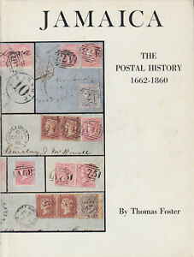
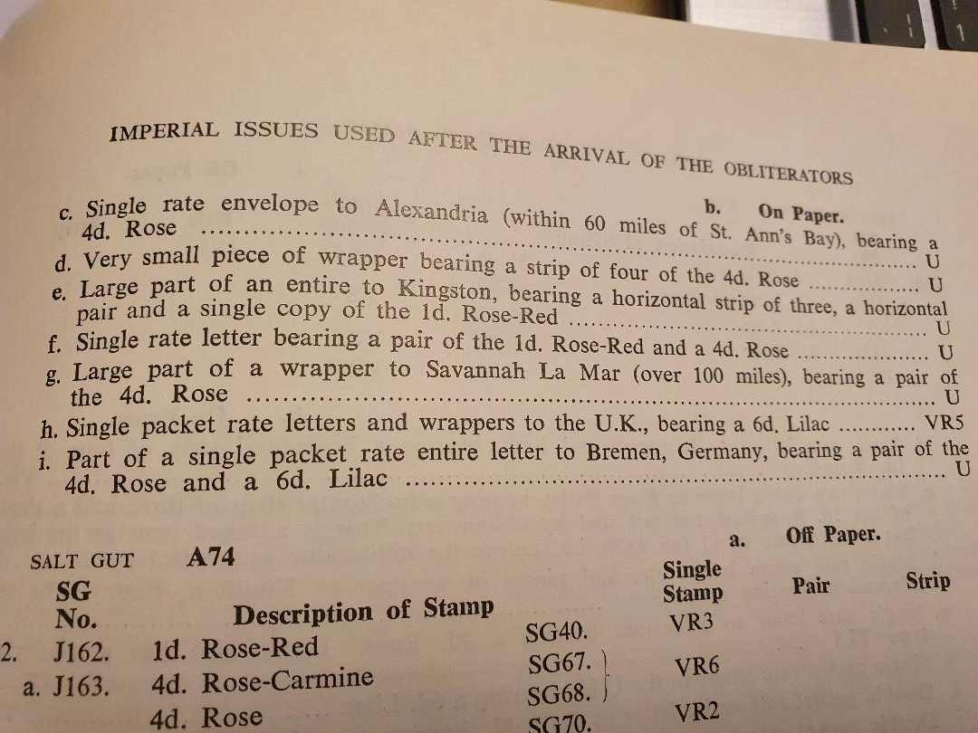
Is it scarce or rare or…I have no idea
I bought this book 2nd hand
VR5 = very rare, 5 known

Slide 13
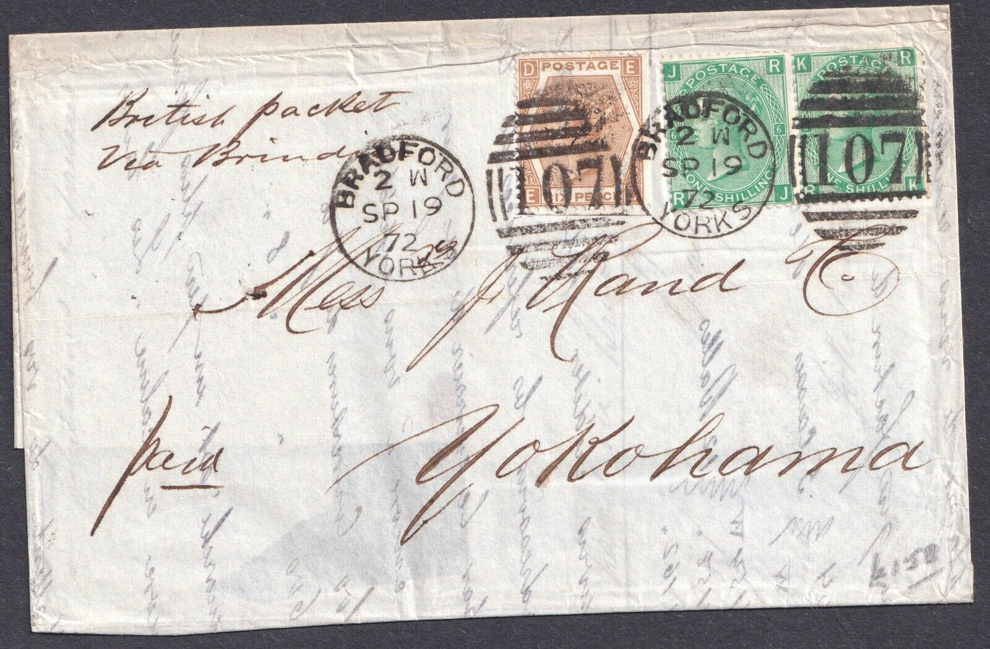
1872. 2/6d double rate
Bradford to Yokohama
Via Brindisi
Silk merchants
Contains a £90,000 bill!

Slide 14
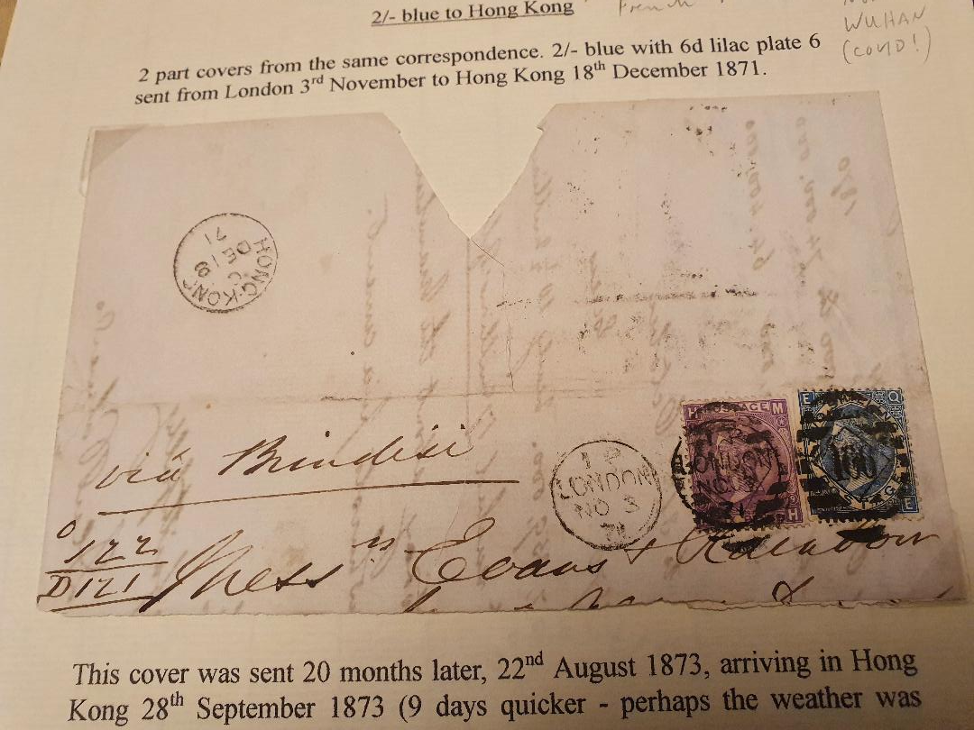
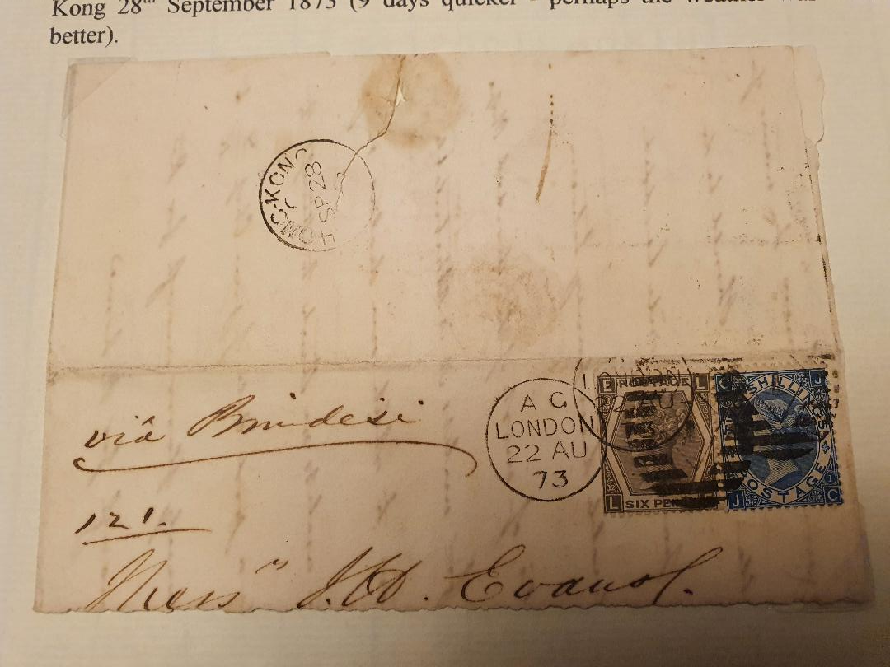
Old material, new (lockdown) discoveries

Slide 15
Pair of sliced covers to Hong Kong
I could make out Evans and Rainbow.
I did some internet searches and found an interasia auction of similar letters to Hankow, China
Very desirable and rare
The letters went to Brindisi, Hong Kong, Shanghai and then up the Yangtze river to Hankow…
…which is now known as Wuhan aka ‘Covid central’!

Slide 16
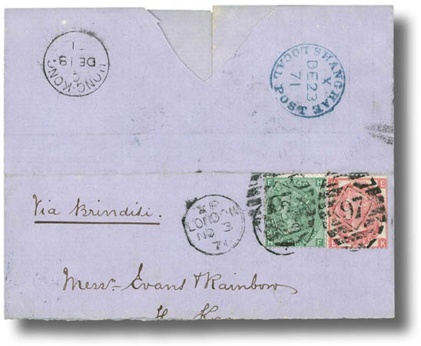
Interasia Auction 2016
This is dated the same as one of my covers, 3rd November 1871.
They sailed together across the world.
Mine was a few quid…this one went for HK$32200!!!

Slide 17
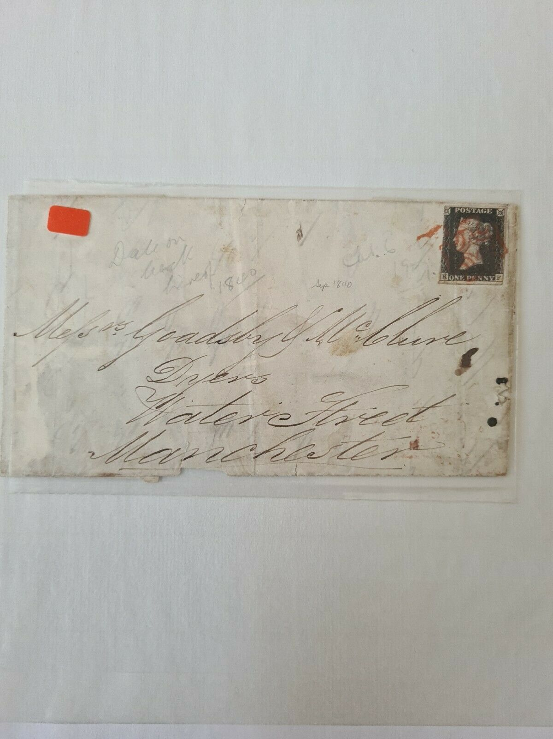
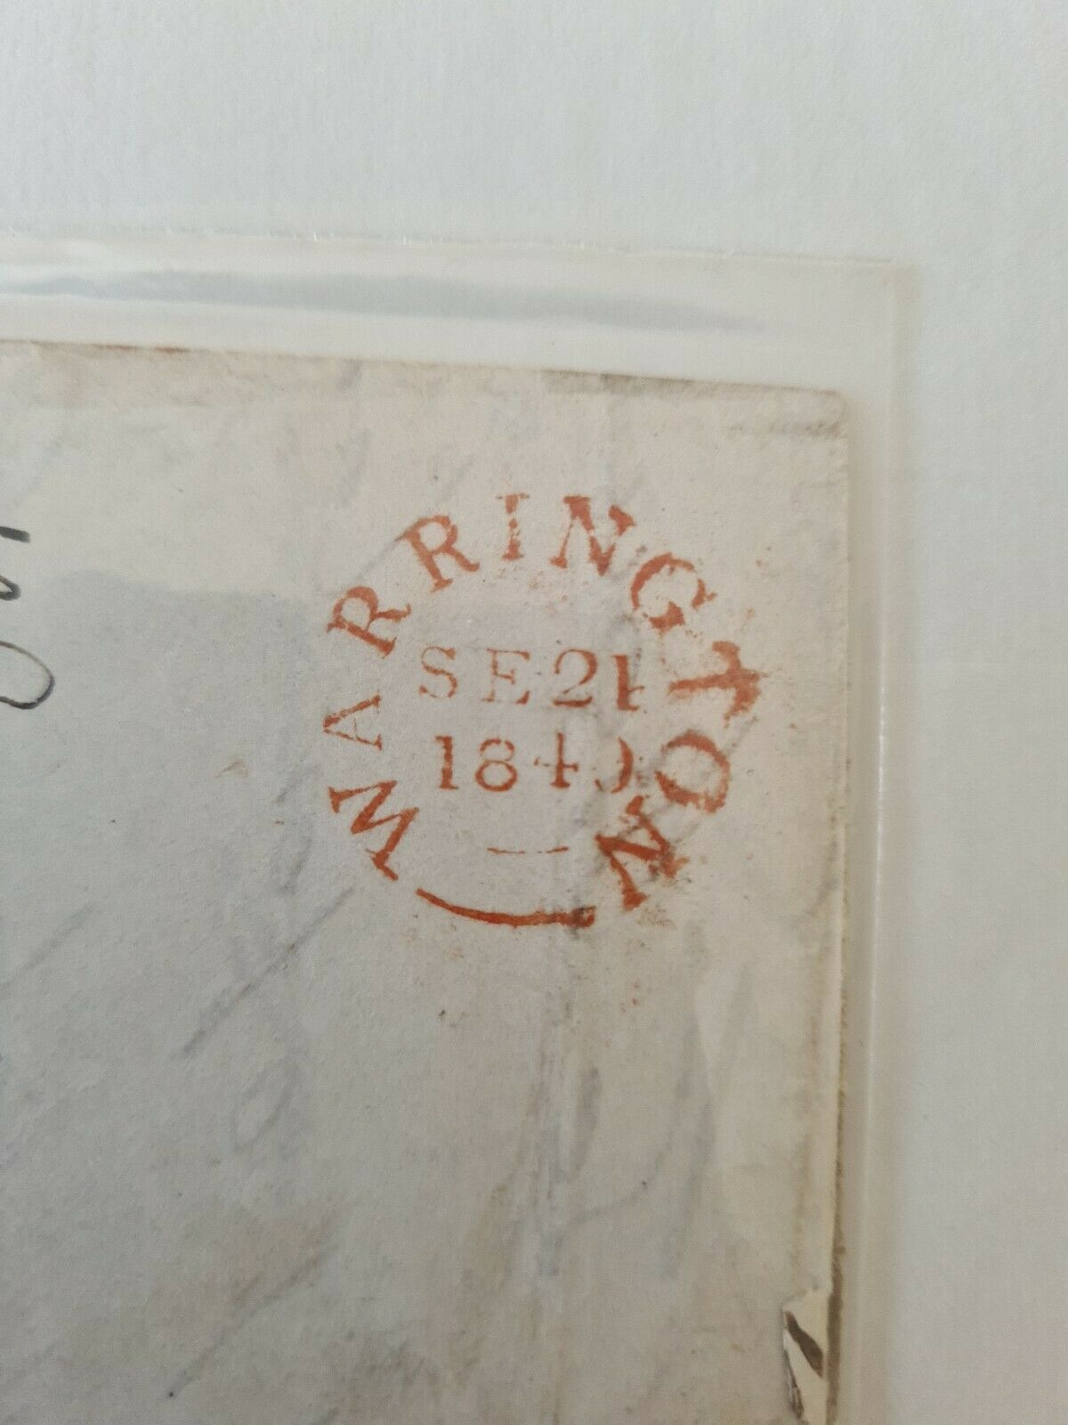
Warrington 1840

Slide 18
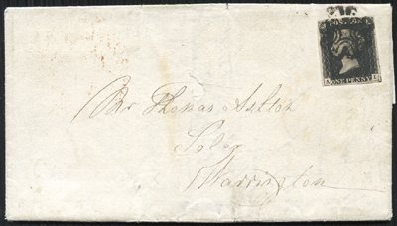
Manchester to Warrington 21st May 1841

Slide 19
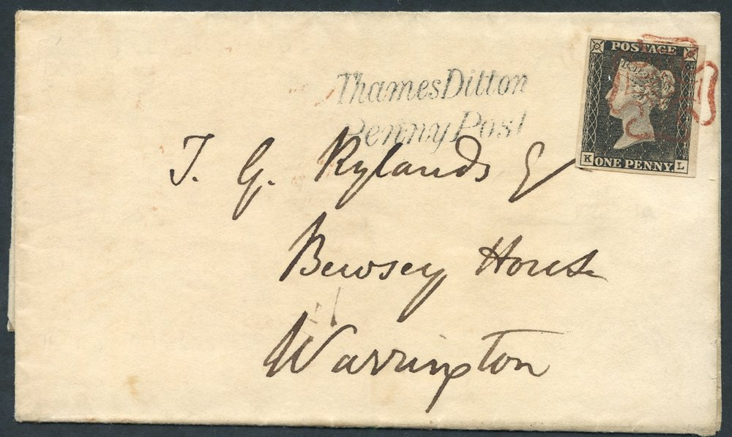
Pièce de résistance - Kingston upon Thames to Warrington 15th May 1840 (not mine!)

Slide 20
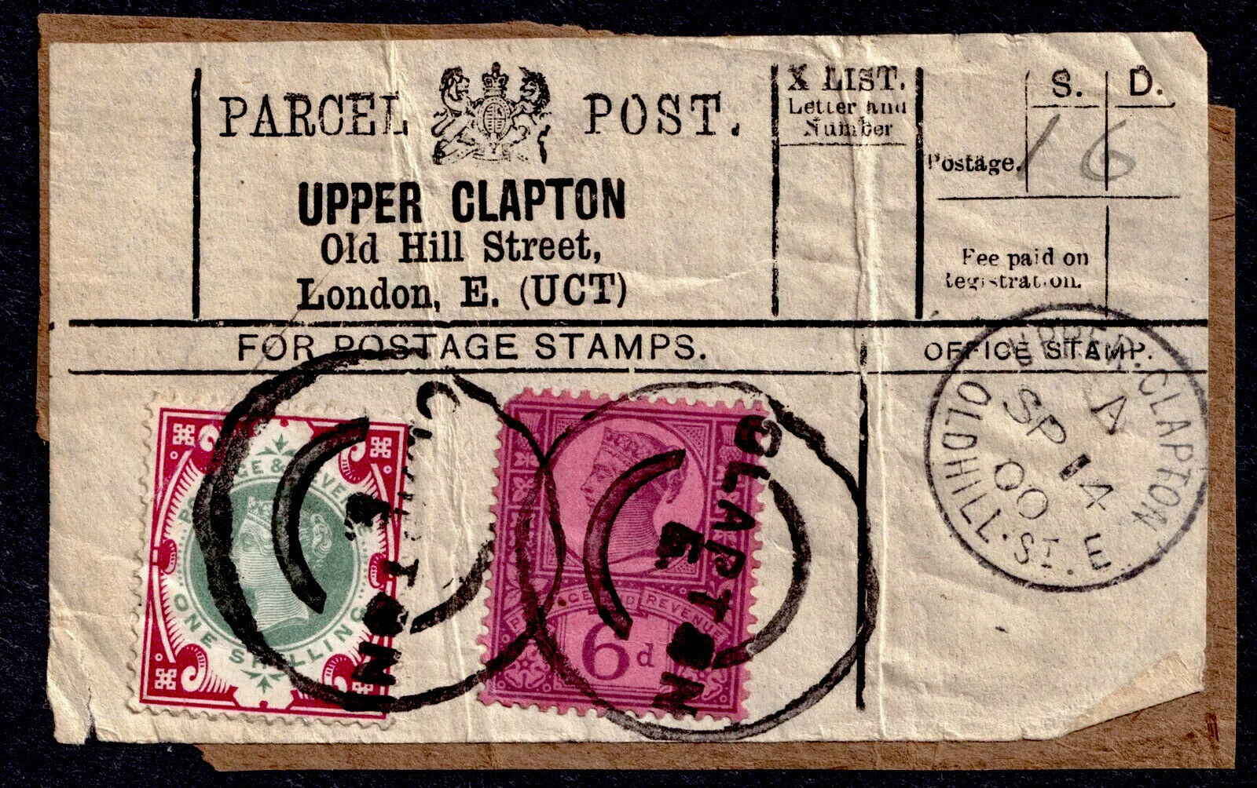
Items I didn’t win on
Really scarce parcel label with 1/- green and carmine
I’ve never seen another one, nor had the vendor
I was outbid. It’s creased, damaged, the 6d has a corner missing…didn’t want it anyway!
Can’t win ‘em all !

